Slide 1
Bone Tumours

Slide 2
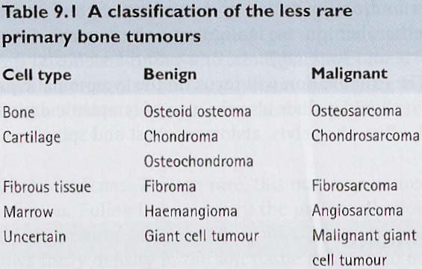

Slide 3
Mechanisms of spread
• Local
• Haematogenous
• Lymphatic
• Intramedullary
• Others e.g. injections, transfer (iatrogenic)

Slide 4
Clinical Diagnosis of tumours
a) Age of patient;
• < 5yrs old - Malignant
• 5-30yrs old - Benign; Also Ewing's sarcoma & Osteosarcoma
• 30-60yrs - Mixed - Chondrosarcoma, Fibrosarcoma
• > 60yrs - Secondaries (malignant); Multiple myeloma

Slide 5
b) Symptoms;
• Benign - No pain
• Malignant - Vascular pain - Worse at night & throbbing due to ischemia due to increased blood
demand; Also 2° to pressure effect on bone & soft tissue

Slide 6
c) Duration of symptoms;
• 3 months - Malignant
• 6 months - Borderline
• 1 year - Benign

Slide 7
d) Imaging;
• Benign - well defined transitional zone with regular/Scalloped margins e.g. Osteochondroma which
are mostly metaphyseal especially around the knee & may be pediculated or sessile
• Malignant - Diffuse transitional zone

Slide 8
Enneking System of Classifying Musculoskeletal Tumours
I - All low-grade sarcomas with <25% chance of metastasis e.g. 2° chondrosarcoma, Parosteal
osteosarcoma
II - Histologically high-grade lesions with >25% chance of metastasis e.g. osteosarcoma & fibrosarcoma
III - Sarcomas which have metastasized
+
A - Intracompartmental e.g. A lesion contained in a single muscle belly or a bone lesion that has not broken out
into the surrounding soft tissue
B - Extracompartmental e.g. A lesion in the popliteal space, axilla, pelvis, or midportion of the hand or foot

Slide 9
Osteosarcoma
Osteosarcoma is a high grade malignant tumour arising within the bone &
Spreading rapidly outwards to the periosteum & surrounding soft tissues.
Epidemiology
• Children > Adults - 5-19yrs; 22-26yrs - This has been attributed to increased bone growth
• Adults - ≥60yrs - History of exposure to radiation when young &/or bone infection
• M:F - 2:1

Slide 10
Pathogenesis
The tumour is usually situated in the metaphysis of a long bone, especially around the knee & at the proximal end of the humerus, where it destroys & replaces normal bone. Areas of bone loss & cavitation alternate with dense patches of abnormal new bone. The tumour extends within the medulla & across physeal plate. There may be obvious spread into the soft tissues with ossification at the periosteal margins & streaks of new bone extending into the extra-osseous mass. The tumour spreads mostly haematogenously > intramedullary > local spread. Rarely lymphatic.

Slide 11
Classification
a) Primary;
• Central (classical)
* High grade - Distal femur, proximal tibia & proximal humerus
• Juxtacortical;
* Low grade (Parosteal) - Distal femur
* Intermediate grade (Periosteal) - Shaft of long bones
* High grade (surface sarcoma) - Shaft of long bones
• Haemorrhagic or Telangiectatic;
* High grade - Epiphysis

Slide 12
b) Secondary (arise secondary to):
• Paget's disease
• Radiation
• Fibrous dysplasia

Slide 13
Clinical presentation
• Pain - constant, worse at night & gradually increases in severity
• Swelling
• Local tenderness
** Pathological fracture is rare

Slide 14
Investigations
X-Ray;
i) Hazy osteolytic lesions alternating with unusually dense osteoblastic areas
ii) The endosteal margin is poorly defined
iii) The cortex is breached & the tumour extends into the adjacent tissues; when this happens, streaks of new
bone appear radiating outwards from the cortex - Sunburst effect
iv) Where the tumour emerges from the cortex, reactive new bone forms at the angles of periosteal elevation -
Codman's triangle

Slide 15
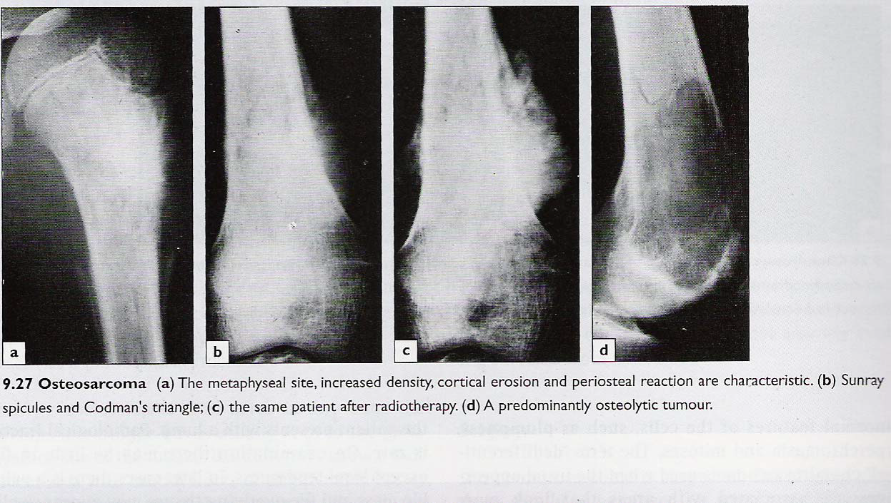

Slide 16
Blood;
- FHG + ESR
- ↑ ALP + LDH
• CT for staging - Pulmonary CT is a much more sensitive detector of lung metastases which are present in about 10% of patients at presentation.
• Liver ultrasound
• Scintigraphy using Methyldiphosphonate PC99 (MDP)- For skip lesions
• Biopsy;
* FNAC
* Incisional biopsy - All layers from skin to bone
* Excisional biopsy - Wide margin (at least 2mm)
• MRI is NOT very useful

Slide 17
differentials
• Stress fracture
• Infection - Acute osteomyelitis
• Post-traumatic swelling
• 'Cystic' lesions
• Other tumours

Slide 18
Management
a) Supportive
b) Specific
• Multi-agent neo-adjuvant chemotherapy is given for 8-12wks;
* Eliminates micrometastasis
* Reduces size of tumour reactive zone
* Causes tumour necrosis
Then provided the tumour is resectable & there are no skip lesions, a wide resection is carried out.
The segment of bone is replaced with either a large bone graft or a custom made implant; in some cases, amputation may be more appropriate.
The tumour responds well to Methotrexate, Adriamycin, Cisplatin, Ifafosphamide

Slide 19
Prognosis
Long-term survival after wide resection & chemotherapy - 50-60% if treated early & <10% if late presentation.

